Slide 1
PUERTO RICO MASTER SCIENCE TEACHERS CERTIFICATION PROGRAM
PR-MSP Puerto Rico Math & Science Partnership
NATIONAL SCIENCE TEACHERS ASSOCIATION
INDIANAPOLIS
MARCH 31, 2012

Slide 2
PRMSTCP
Is a supplemental NSF fund given to Puerto Rico Math & Science Partnership (PR-MSP)
The project is known as AlACiMa, an acronym for Alliance for Learning Science and Mathematics.

Slide 3
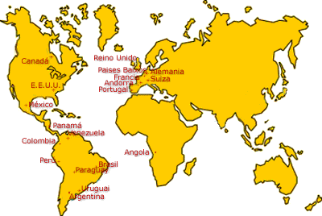

Slide 4
MST CURRICULUM
MST I
Composting Water Quality Leadership workshop
(70 immersion hours)
MST II
Follow up and transfer to classroom
(60 hours)
MST III
Biotechno-logy immersion
(70 hours)
MST IV
Follow up and transfer to classroom
(60 hours)

Slide 5
MST CURRICULUM
MST V Energy Transfer (30 hours)
MST VI
Two-week residential immersion scientific research course
(70 hours)
MST VII
Action research focused on special needs students
(60 hours)
MST VIII
Portfolio presentation Cooperating teacher course
(60 hours)

Slide 6
ACTION RESEARCH FOCUSED ON SPECIAL NEEDS STUDENTS (SNS)

Slide 7
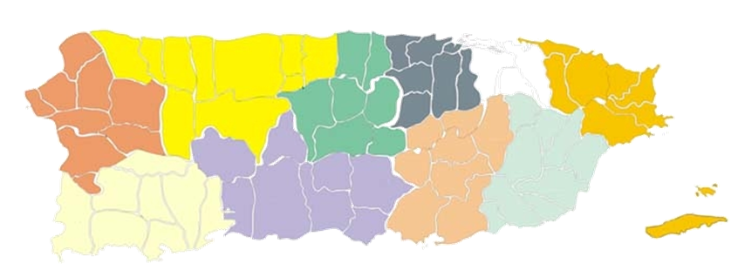
OUR FELLOWS

Slide 8
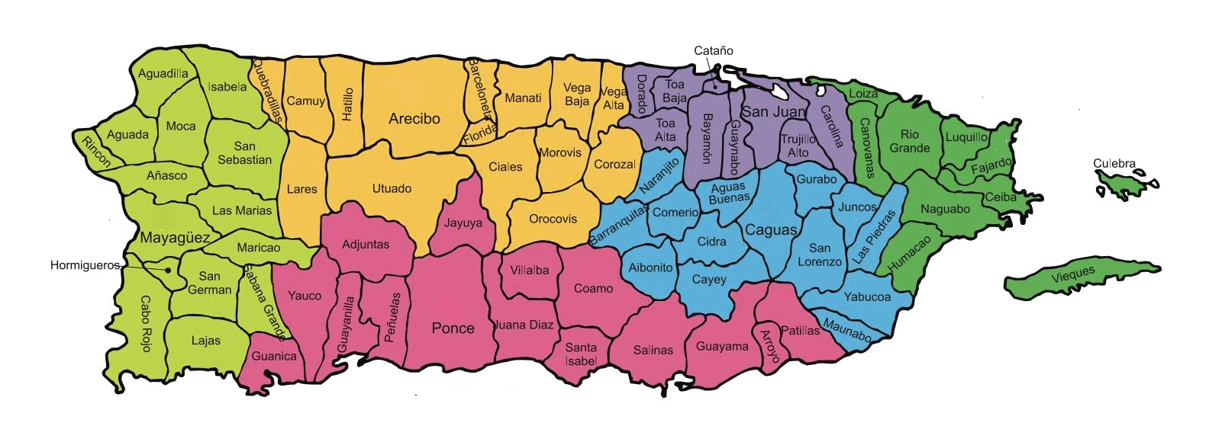
OUR FELLOWS

Slide 9
Special Needs Students’ Cognitive Process Solving Stoichiometry Problems Myrna Hernández

Slide 10
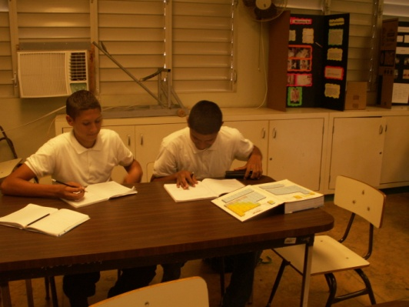
Special Needs Students’ Cognitive Process Solving Stoichiometry Problems
Research Question
Is the structured solving problem approach effective to improve the capacity of students to solve stoichiometry problems?
Strategies
1. Structured problem modeled by the teacher repeated by the students
2. Peer coaching – two students working together
3. Continuous assessment

Slide 11
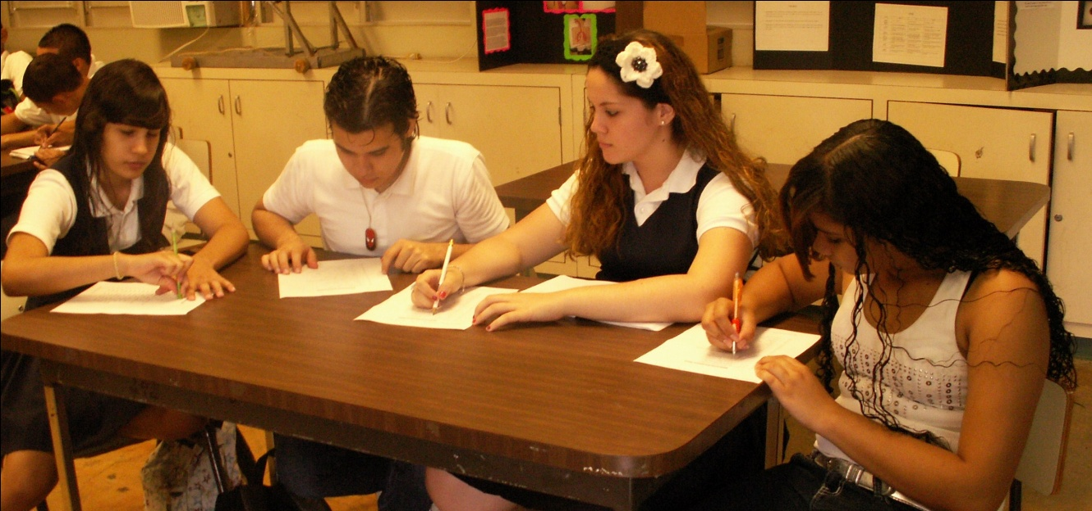
Data Collection
Pre/post -test
Interviews
Student Worksheets – stoichiometry problems
Quizzes
Photos
In

Slide 12
Results
STUDENTS | PRE-TEST (%) | POST-TEST (%)
MAINSTREAM | 40 | 83
SPECIAL NEEDS | 60 | 68
The students feedback was positive and they found
the strategy effective to improve their problem
solving skills.

Slide 13
A Modified Chemistry Laboratory to Enhance Conceptual Understanding in Special Needs Students Javier González-Rosado

Slide 14
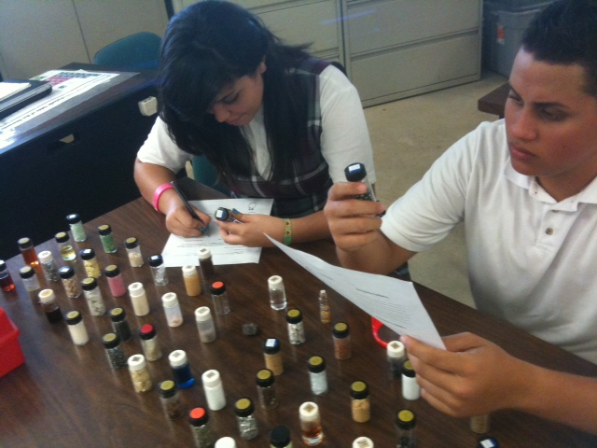
A modified chemistry laboratory to enhance conceptual understanding in special needs students
Research Question
Is this laboratory approach effective in enhancing conceptual understanding of the classification of matter in special needs students?
Strategies:
Use of manipulative
Cooperative groups
Socialized discussion

Slide 15
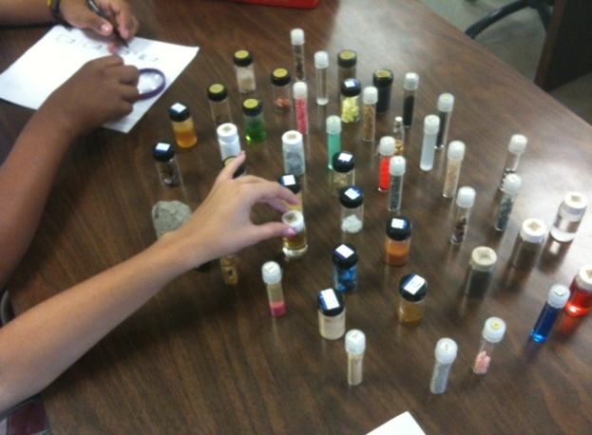
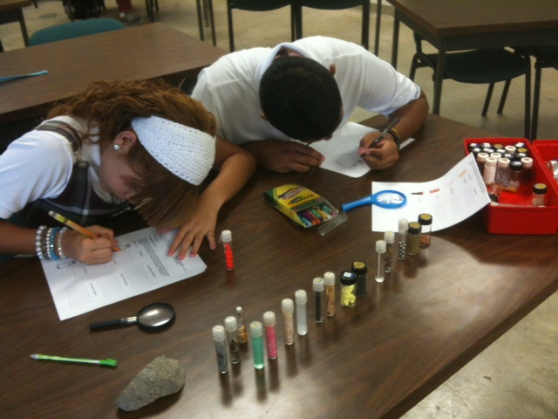
Data Collection
Pre/Post test
Focus groups
Drawing

Slide 16
Results
Students | Pre-test | Post-test
Main Stream | 15% | 47%
SNS | 10% | 35%
The majority of the group has the opinion that this activity helped them acquire new understanding of the matter, have more observation skills and develop a better analysis to understand the characteristics of compounds, elements, solutions and mixtures.

Slide 17
A Synectic Learning Model as an Effective Strategy in Teaching the Mol Concept to Special Needs Students Carmen Ruiz

Slide 18
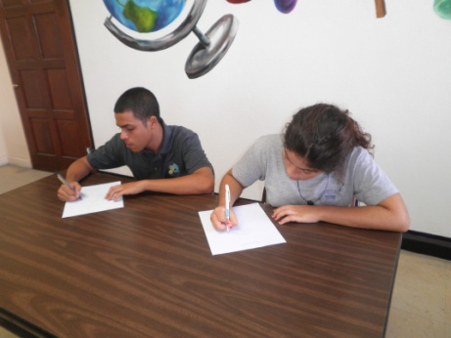
A Synectic Learning Model as an Effective Strategy in Teaching the Mol Concept to Special Need Students
Research Question
Is the synectic model an effective tool for enhancing
conceptual understanding of the mol in special needs
students?
Strategies
Cooperative groups
Continuous assessment
Student worksheets

Slide 19
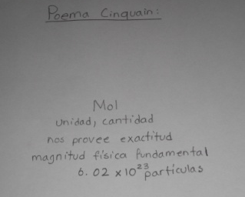
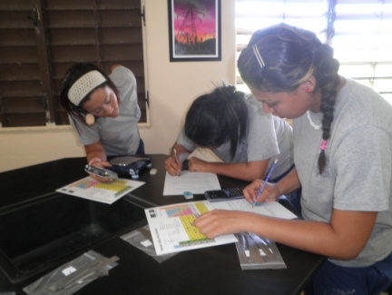
Data Collection
Pre/post test
Syntu and Cinquian Poems
Laboratory Report
Notes:
Añadir fotos… Crame enviará luego

Slide 20
Results

Slide 21
In situs lab with Danaus plexippus lifecycle Minnuette Rodríguez Harrison

Slide 22
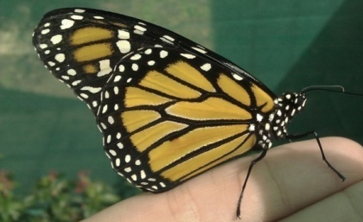
In situs lab with Danaus plexippus lifecycle
Research Question
Is the strategy of taking care of a butterfly nursery help special needs students to understand the life cycle of the specie Danaus plexippus?
Strategies
In site laboratory (Butterfly Nursery)
Cooperative groups
Continuous assessment

Slide 23
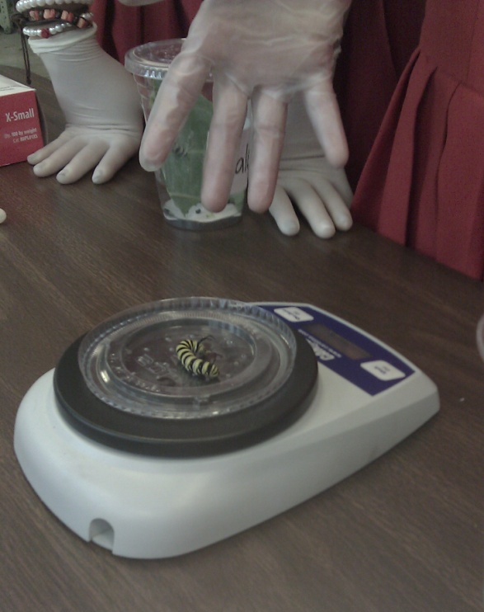
Data Collection
KWL Technique
Videos and photos (Monarchs’ lifecycle)
Growth and development data sheet
Reflective journal
Drawing

Slide 24
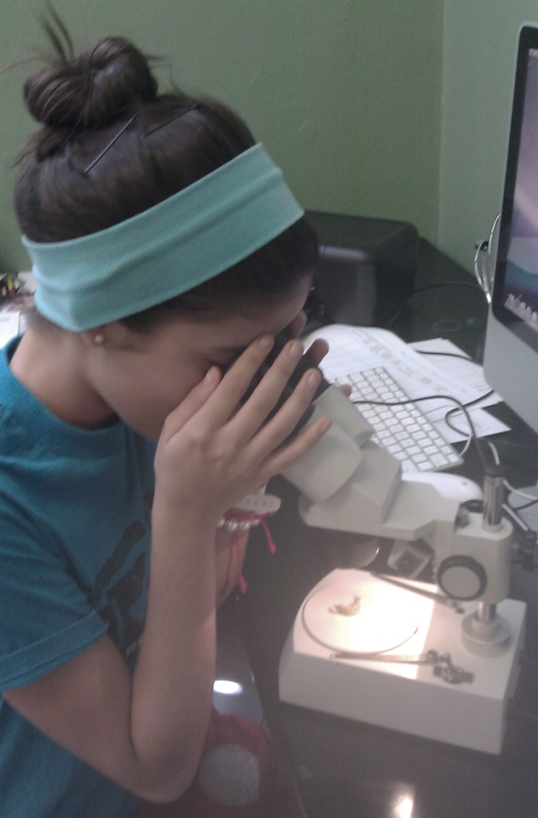
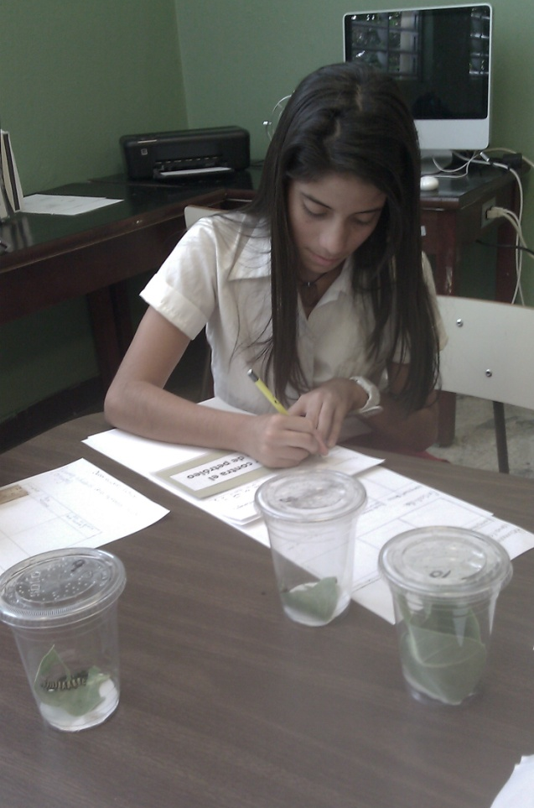
Daily Observations

Slide 25
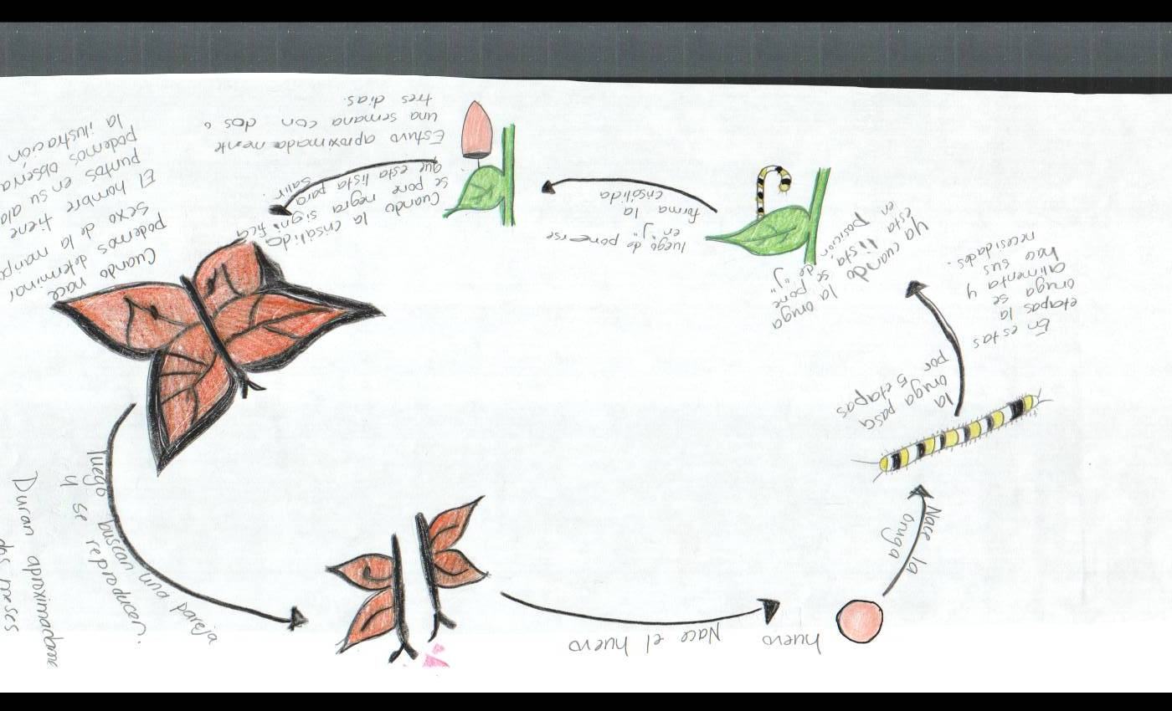
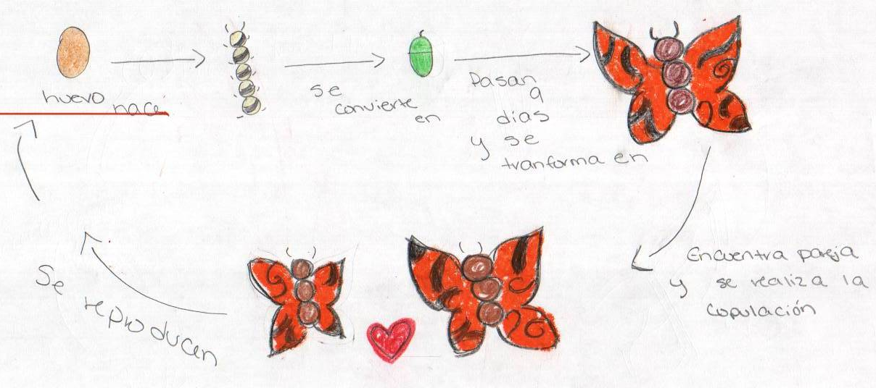
Students | Pre-Drawing | Post-Drawing
Main Stream
SNS

Slide 26
students | % pre | % post | students | % pre | % post
1 (SNS) | 38 | 88 | 6 | 38 | 100
2 | 63 | 100 | 7 | 75 | 100
3 | 75 | 100 | 8 | 38 | 100
4 | 50 | 100 | 9 | 25 | 88
5 | 38 | 88 | 10 | 75 | 88

Slide 27
A Guided Scientific Research: An Investigation by Special Needs Students Jadira Aponte

Slide 28
A Guided Scientific Research: An Investigation by Special Needs Students
Research Question
What is the effect of working together (coaching) with special needs students to complete a scientific investigation?
Strategies
Cooperative Learning
Peer Coaching
Continuous Assessment

Slide 29
Data Collection
Pre/post test
Interviews
Focus Group
Reflective journal

Slide 30
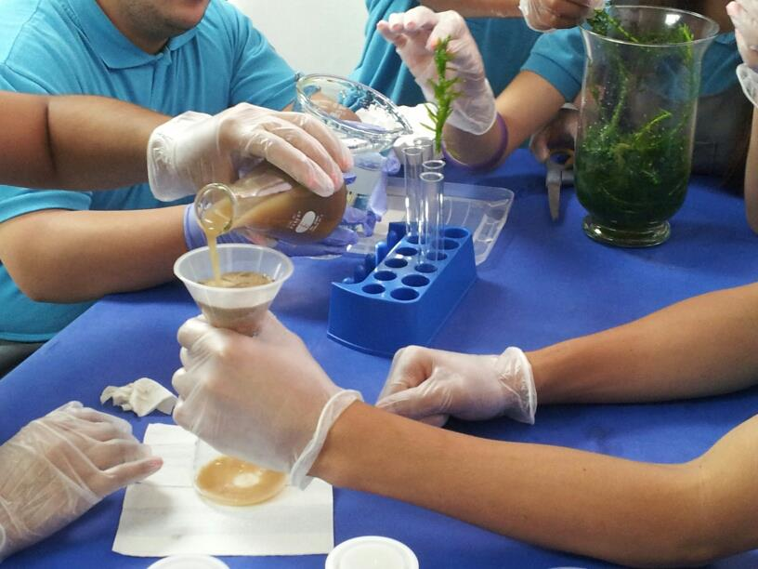
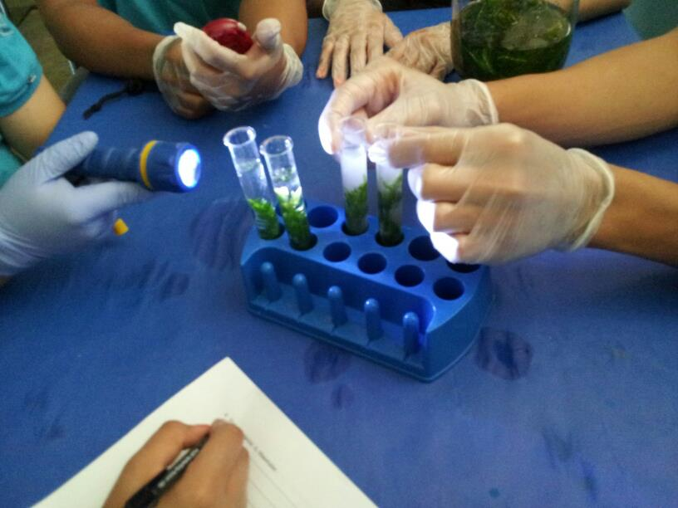
What is the effect of compost in a production of the oxygen in a Egeria densa aquatic plant?
The students are preparing the experiment: filtering the compost and lackeying the aquatic plant in the essay tube.
They are observing the production of oxygen in the aquatic plant.

Slide 31
Result
Reflection
Through qualitative data collection the students expressed that after this experience they felt more confident, relaxed, secured.
All students including special needs students can do scientific research. The SNS require continuous follow up at school and home and motivation.

Slide 32
Different teaching methodologies to enhance the learning of photosynthesis of seventh grade students Lourdes E. Rivera González

Slide 33
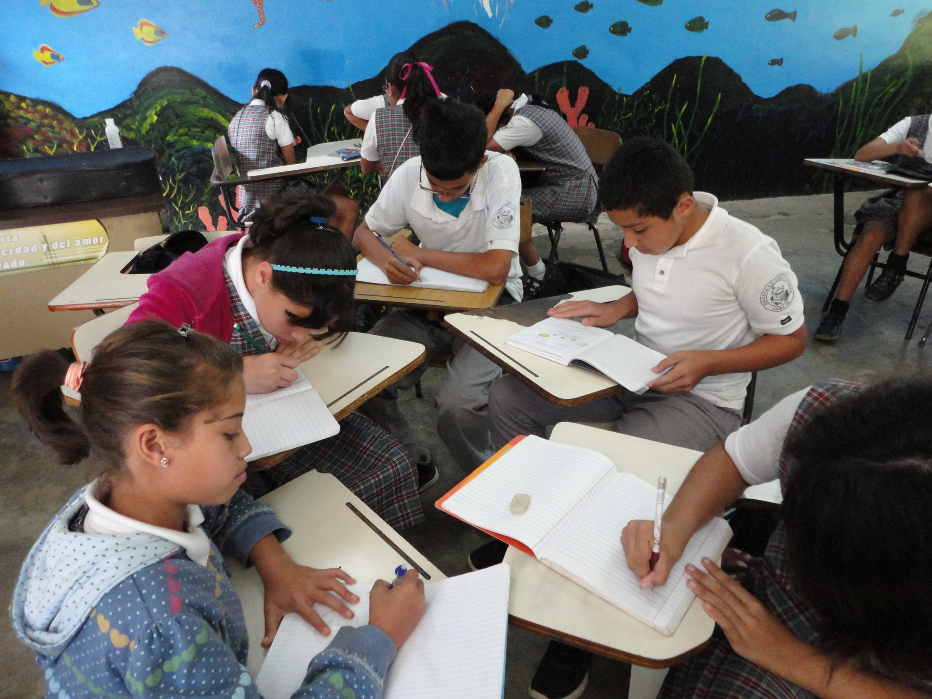
Different teaching methodologies to enhance the learning of photosynthesis of seventh grade students
Problem
Which assessment is more effective to enhance the learning of photosynthesis of seventh grade students?

Slide 34
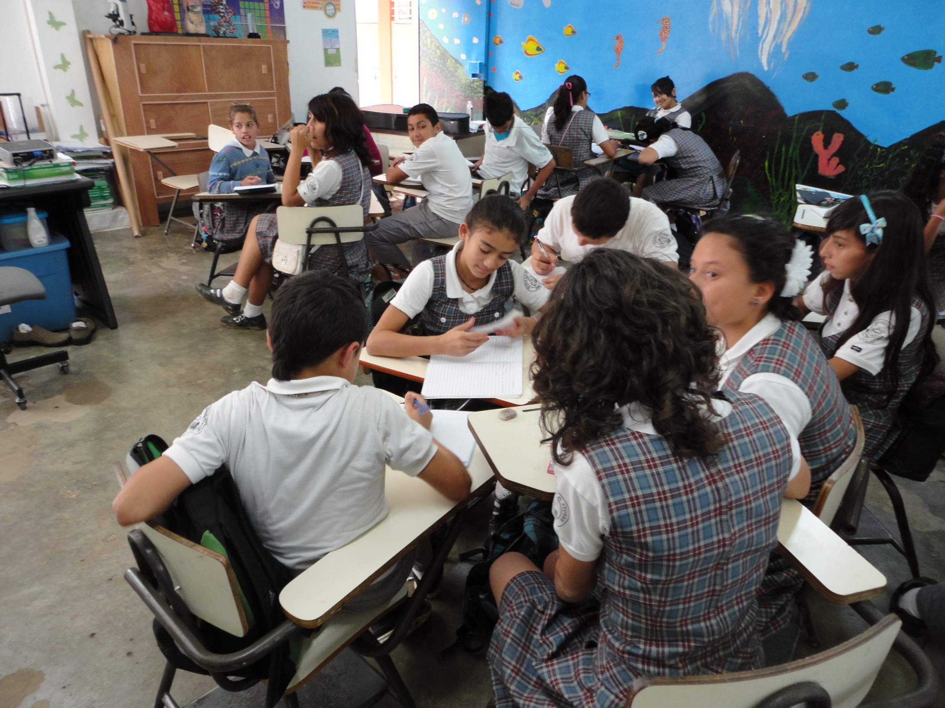
Strategies
Continues assessment
Drawing
Conceptual map
Open questions
Collaborative groups

Slide 35
Results

Slide 36
Using the technological tool Photo Story 3 for Windows as a motivational resource to improve academic achievement of Special Needs Students María L. Ortiz Hernández

Slide 37
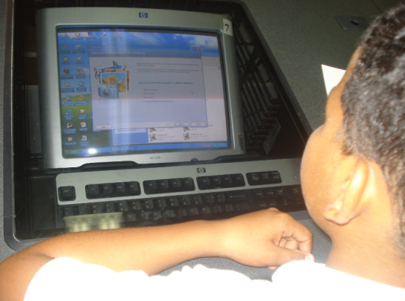
Using the technological tool Photo Story 3 for Windows as a motivational resource to improve academic achievement of Special Needs Students
Research’s question
Is the technological tool Photo Story 3 for Windows a good motivational resource to improve academic achievement of Special Needs Students in the skills of reading and writing science comprehension?

Slide 38
Introduction
For the past ten years the level of performance of seventh grade students have diminished in the areas of reading and writing comprehension in the science class. This issue has been observed with both
mainstream students (MS)
special needs students (SNS)
more pronounced
As a result of these observations I started looking for educational tools that allow me to reinforce these basic skills at the level of student performance and comprehension

Slide 41
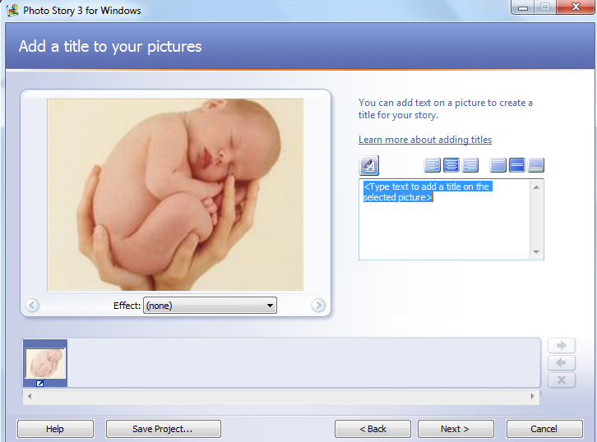

Slide 43
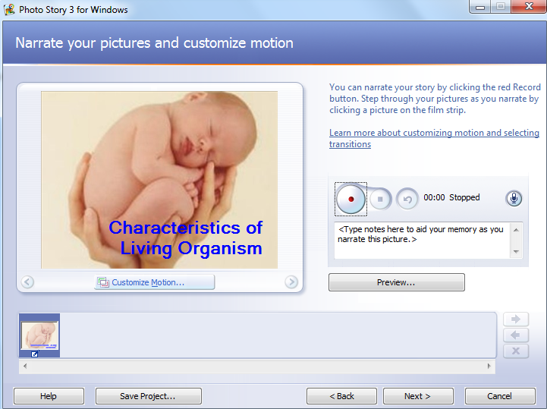

Slide 47
Population
22 seventh grade students
19 MS
3 SNS
integrated into the mainstream
participated of a resource room which provides reinforcements in the Spanish and Mathematics areas.
FOTO

Slide 48
Educational interventions
Short readings on the characteristics of living things
The readings were performed in six different time periods.
The participants had 15 minutes to read the daily topic.
Once the participant s read the assigned topic they took a short pre-test on reading comprehension
4 multiple-choice questions
1 open question

Slide 49
The teacher clarified doubts that might arise from the participants in the processes of
reading
using videos
power point presentations
oral discussion
Once the teacher assisted the participants, they took the short post-test.

Slide 50
Data Collection
Pre/Post test – characteristic of living organism
13 multiple-choice exercises
The results were tabulated to determine the knowledge of the participant at the beginning and at the ending of the process.
Short pre/post test
4 multiple-choice exercises and one open-response exercise.

Slide 51
Data Collection
Presentation script
Students final script
FOTOS

Slide 52
Data Collection
The teacher prepared six folders with images corresponding to each of the characteristics of living things for the students to complete their task.
Internet not available
ES NECESARIO ESTE SLIDE??

Slide 53
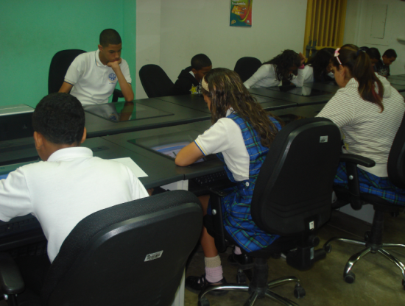
Data Collection
Create presentation of the subject using the technological tool "Photo Story 3 for Windows”
The presentation was used as another mechanism to determine the knowledge acquired and was assessed using a rubric designed for this purpose.

Slide 54
Results
Students | Pre test % |  |  | Post test
 | 100-70% | 69-50% | <50% | 100-70% | 69-50% | <50%
MS | 10 | 20 | 80 | 58 | 0 | 0
SN | 0 | 0 | 100 | 0 | 100 | 0
The results of the pretest showed that 100% of MS and SNS did not mastered the subject matter.
MS Pretest:10% of the MS scored in from 69% to 62%, 10% scored 54% and, 80% scored less than 46%.
MS Postest: 26% of the MS obtained 77% or more, 32% scored 62% to 69% and 37% scored less than 54%.
SNS Pretest: 1 SNS scored 33% and the other 2 scored 23%.
SNS Postest: 2 of 3 of the SNS scored between 62% to 69% and 1 participant had 50%.

Slide 55
Results and Discussion
Amazingly, in the post-test one of the special needs students obtained a score equal to or greater than that obtained by 74% of the participants in the mainstream.
NO APARECE ASI EN LA TABLA ANTERIOR
When the professor intervened to clarify the doubts, after they read individually, all participants improved their scores on the quizzes that were taken of each characteristic of living beings.
Students in the mainstream had better scores.

Slide 56
Results and Discussion
The 95% of participants completed their draft working with the technological tool.
Recent research has shown that students with learning disabilities that have had an instructional based of technological tools, improved their language when performing written work and are able to match their educational needs with these technological tools, (King, Swanson & Mainzer, 2011).necesito que me aclaren esta parte. ESTO LO PONDRIA AL PRINCIPIO

Slide 60
Conclusion
The final product showed that the technological tool Photo Story 3 for Windows allowed the students to have better performance when discussing the topic of the Characteristics of living organisms.
Students did not answer open questions on a quiz because they were reluctant to write, but they were motivated to complete the draft required with the technological tool, indicating that the desired results were achieved.
Although we can not attribute to the technological tool "Photo Story 3 for Windows" the total academic improvement, the process had a set of successful strategies. We can say that this tool was the element that cause participants to complete their work specially to reluctant writers.

Slide 61
Future interventions
Determine whether the interventions and methods of assessment used in this research will be equally effective:
to discuss other topics of the Science curriculum in seventh grade.
in all groups who take my course.
Se necesita aumentar la cantidad de SNS para estar segura de la validez de esta estrategia

Slide 62
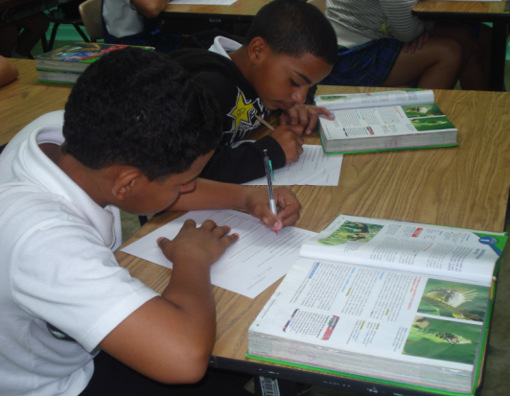
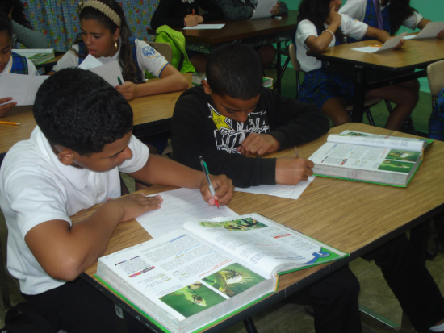
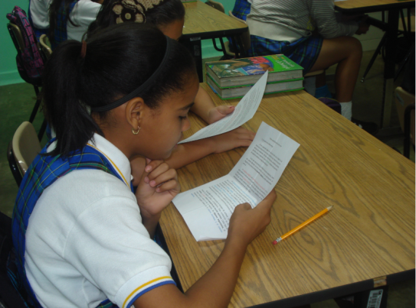
María Ortiz

Slide 63
Technological Module integration to improve the academic
achievement of ADD/ADHD students. Sandra Beltrán

Slide 64
Technological Module integration to improve the academic achievement of ADD/ADHD students. Sandra Beltran

Slide 65
Research question
Is the integration of technology effective to improve the academic achievement of ADD/ADHD students , in the somatic Cell Cycle unit?

Slide 66
Attention Deficit Hyperactivity Disorder
A condition of the brain that makes it hard for children to control their behavior.
It is one of the most common chronic conditions of childhood.
Children with ADHD have frequent, severe problems that interfere with their ability to live normal lives.
Children with ADHD have trouble paying attention, controlling impulsive behaviors (may act without thinking about what the result will be), and, in some cases, are overly active.
American Academy of Pediatrics. (2001). Retrieved http://pediatrics.aappublications.org/content/suppl/2006/02/15/108.4.1033.DC1/P2_1033.pdf
Notes:
Section 504 is a civil rights statute (a federal law) that states that schools cannot discriminate against children with disabilities. It says that schools must give eligible children with disabilities equal opportunity to participate in all academic and nonacademic services the school has to offer and give them accommodations based on their individual needs.
“A student is eligible for Section 504 if the child has a physical or mental condition that substantially limits a ‘major life activity like learning

Slide 67
ADD/ADHD subtypes
Predominantly hyperactive-impulsive
Predominantly inattentive
Combined hyperactive-impulsive and inattentive
DSM-IV-TR workgroup. The Diagnostic and Statistical Manual of Mental Disorders, Fourth Edition, Text Revision. Washington, DC: American Psychiatric Association.
Notes:
ADHD has three subtypes:1
•Predominantly hyperactive-impulsive –
Fidget and squirm in their seats• Talk nonstop• Dash around, touching or playing with anything and everything in sight• Have trouble sitting still during dinner, school, and story time• Be constantly in motion• Have difficulty doing quiet tasks or activities.
Be very impatient• Blurt out inappropriate comments, show their emotions without restraint, and act without regard for consequences • Have difficulty waiting for things they want or waiting their turns in games• Often interrupt conversations or others’ activities.
Predominantly inattentive –
Be easily distracted, miss details, forget things, and frequently switch from one activity to another• Have difficulty focusing on one thing• Become bored with a task after only a few minutes, unless they are doing something enjoyable• Have difficulty focusing attention on organizing and completing a task or learning something new • Have trouble completing or turning in homework assignments, often losing things (e.g., pencils, toys, assignments) needed to complete tasks or activities• Not seem to listen when spoken to• Daydream, become easily confused, and move slowly• Have difficulty processing information as quickly and accurately as others• Struggle to follow instructions.
Combined hyperactive-impulsive and inattentive
If you noticed all mentioned symptoms interrupt the class and the learning process making difficult and in some cases impossible that the student realize an efficient work.

Slide 68
Justification

Slide 69
Justification
Diagnoses of ADD/ADHD among children 6-17 years of age, by age group: United States, 1997-2006
Percent of students with ADD/ADHD between 1997-2006
Notes:
The question is why I decided to work with Student with ADD/ADHD condition.
The first reason is because I noticed in the population of my school an increment of students diagnosed with ADD/ADHD. The last year the school had 7 students in all population and this year we have 30 students diagnose with this disorder, that is an increment of 400%. When make an information search I found that this situation is not only in my school.
Over the past three decades in the United States, behavioral and learning disorders have emerged as major chronic conditions affecting the development of school-aged children and adolescents (1,2). Educators have reported a rise in the number of children with these disorders.
According to the CDC, between the years 1997 to 2006 there was a 3% increase in children diagnosed with ADD/ADHD. In 2007, the estimated prevalence of parent-reported ADHD (ever) among children aged 4--17 years was 9.5%, representing 5.4 million children. Other important factor is an average annual increment of 4% of childrens diagnosed with this condition between 12-17 years of age.

Slide 70
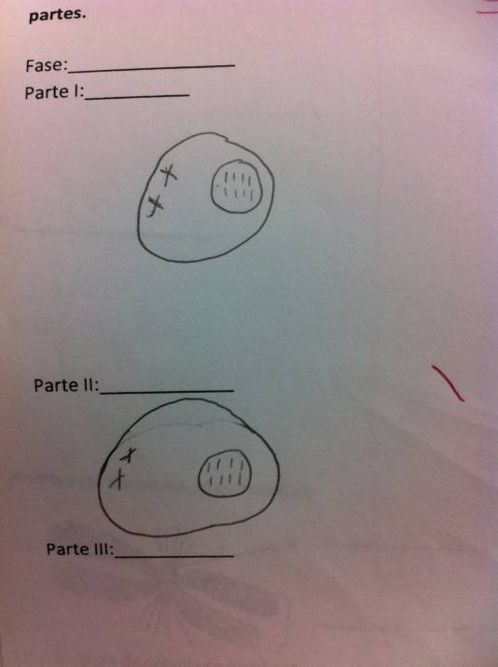
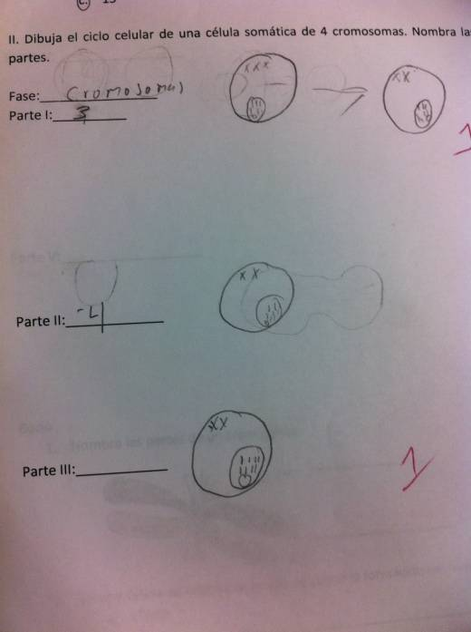
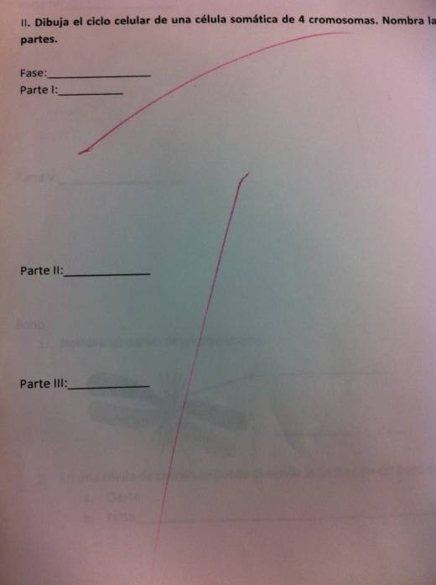
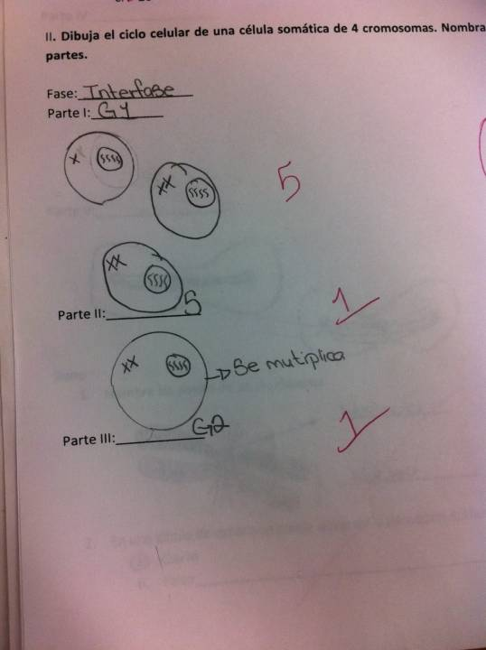
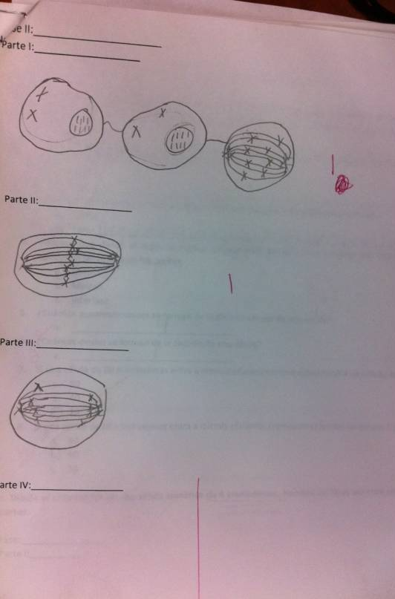
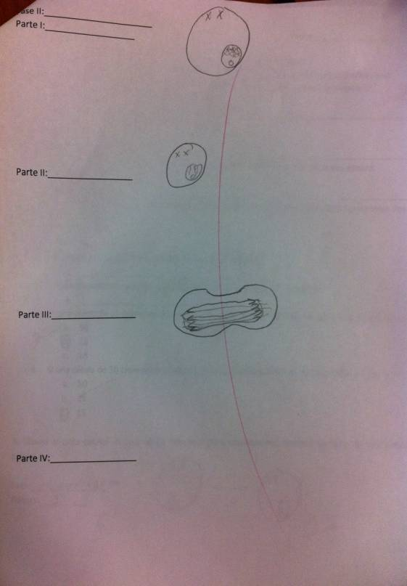
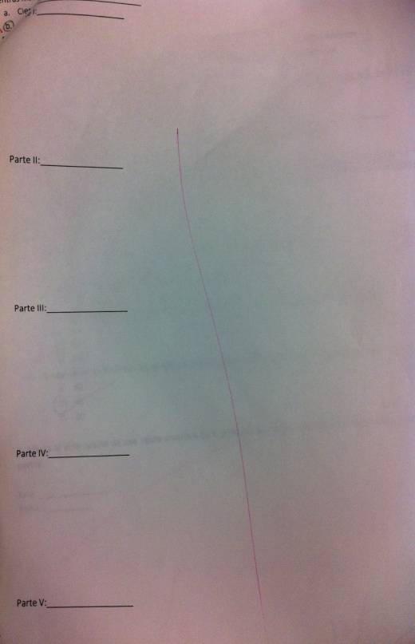
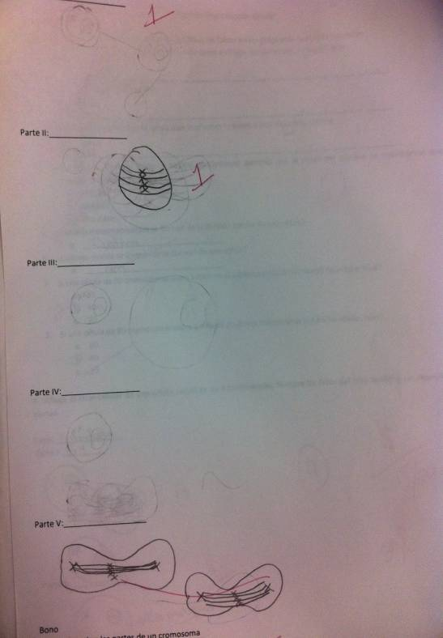
ADD/ADHD Last Year Cell Cycle Mitosis Test
Student #1
Student # 2
Student #3
Student #4
Notes:
The second reason is that based on my experience students with this condition have difficulties to carry out efficient work on topics of high complexity that require know details and sequence of events, as cellular reproduction mitosis. Shown tests are the previous year students who were diagnosed with ADD/ADHD. Observe, some of these students were able to demonstrate, by drawing , only the first steps of the cell cycle, others, performed the first and last, forgetting the intermediate steps and others could not undertake the exercise.

Slide 71
Strategy
Technological Module – Cell Cycle Mitosis Unit
Reinforce the regular class.
The cell cycle unit was divided in four sub-topics:
Different cells and their sizes
Reasons of the cell size limitation
Cell Cycle
Interphase
Mitosis
As the subtopics are covered during the science class, the students will be working the module in the special education classroom
Notes:
With the purpose of increasing the academic achievement of the student, I prepare technological module using strategies that allow that the characteristics of these students do not affect them in their learning process.
How this module could help these students?
This module served as reinforcement, once was offered the subject in class, students visited the special education program and working with the module to reinforce what has been learned.
The unit was divided into shorts topics.
The module is fully interactive allowing the student to repeat it as many times as necessary or forward if already know the concept.
The module has many videos, the information is written and at the same time it is narrated, trying to student to focus on what is watching and listening.
We are going to see a short video of the module

Slide 73
Population
A total of 26 students with ADD/ADHD
The investigation was limited to 7 students.
2 students per group
Reason for the amount of sample
Only two computers at Special Education classroom
Computer lab is not available

Slide 74
Methodology
Assessment
Pre/post test
Quiz of each sub-topic
Different cells and their sizes
Reasons of the cell size limitation
Interphase
Mitosis
Journal
Virtual Lab
Test

Slide 75
Notes:
These graphs show a comparison between the research participants, other students with ADD/ADHD and the total population. Excellent represents 100% up to 90%, satisfactory represents 89 up to 70%, regular represents 69 up to 50% and poor represents 49% or less. In the pre test all the population is between regular and poor. In the post test 86% of the students participating in research conducted a satisfactory job, while students with the same condition that did not use the module 72% carry out a regular job. Show a better performance the students that used the module, even compared with the total population that remained the majority between satisfactory and regular work.

Slide 76
Notes:
The module had a quiz for each topic and students could run it many times as wished. The special education teachers annotated the score of each quiz in three times. Most of the time shows an increase in test scores as they repeated the quiz. The repetition allowed the student acknowledge mistakes, study again and fix it.

Slide 77
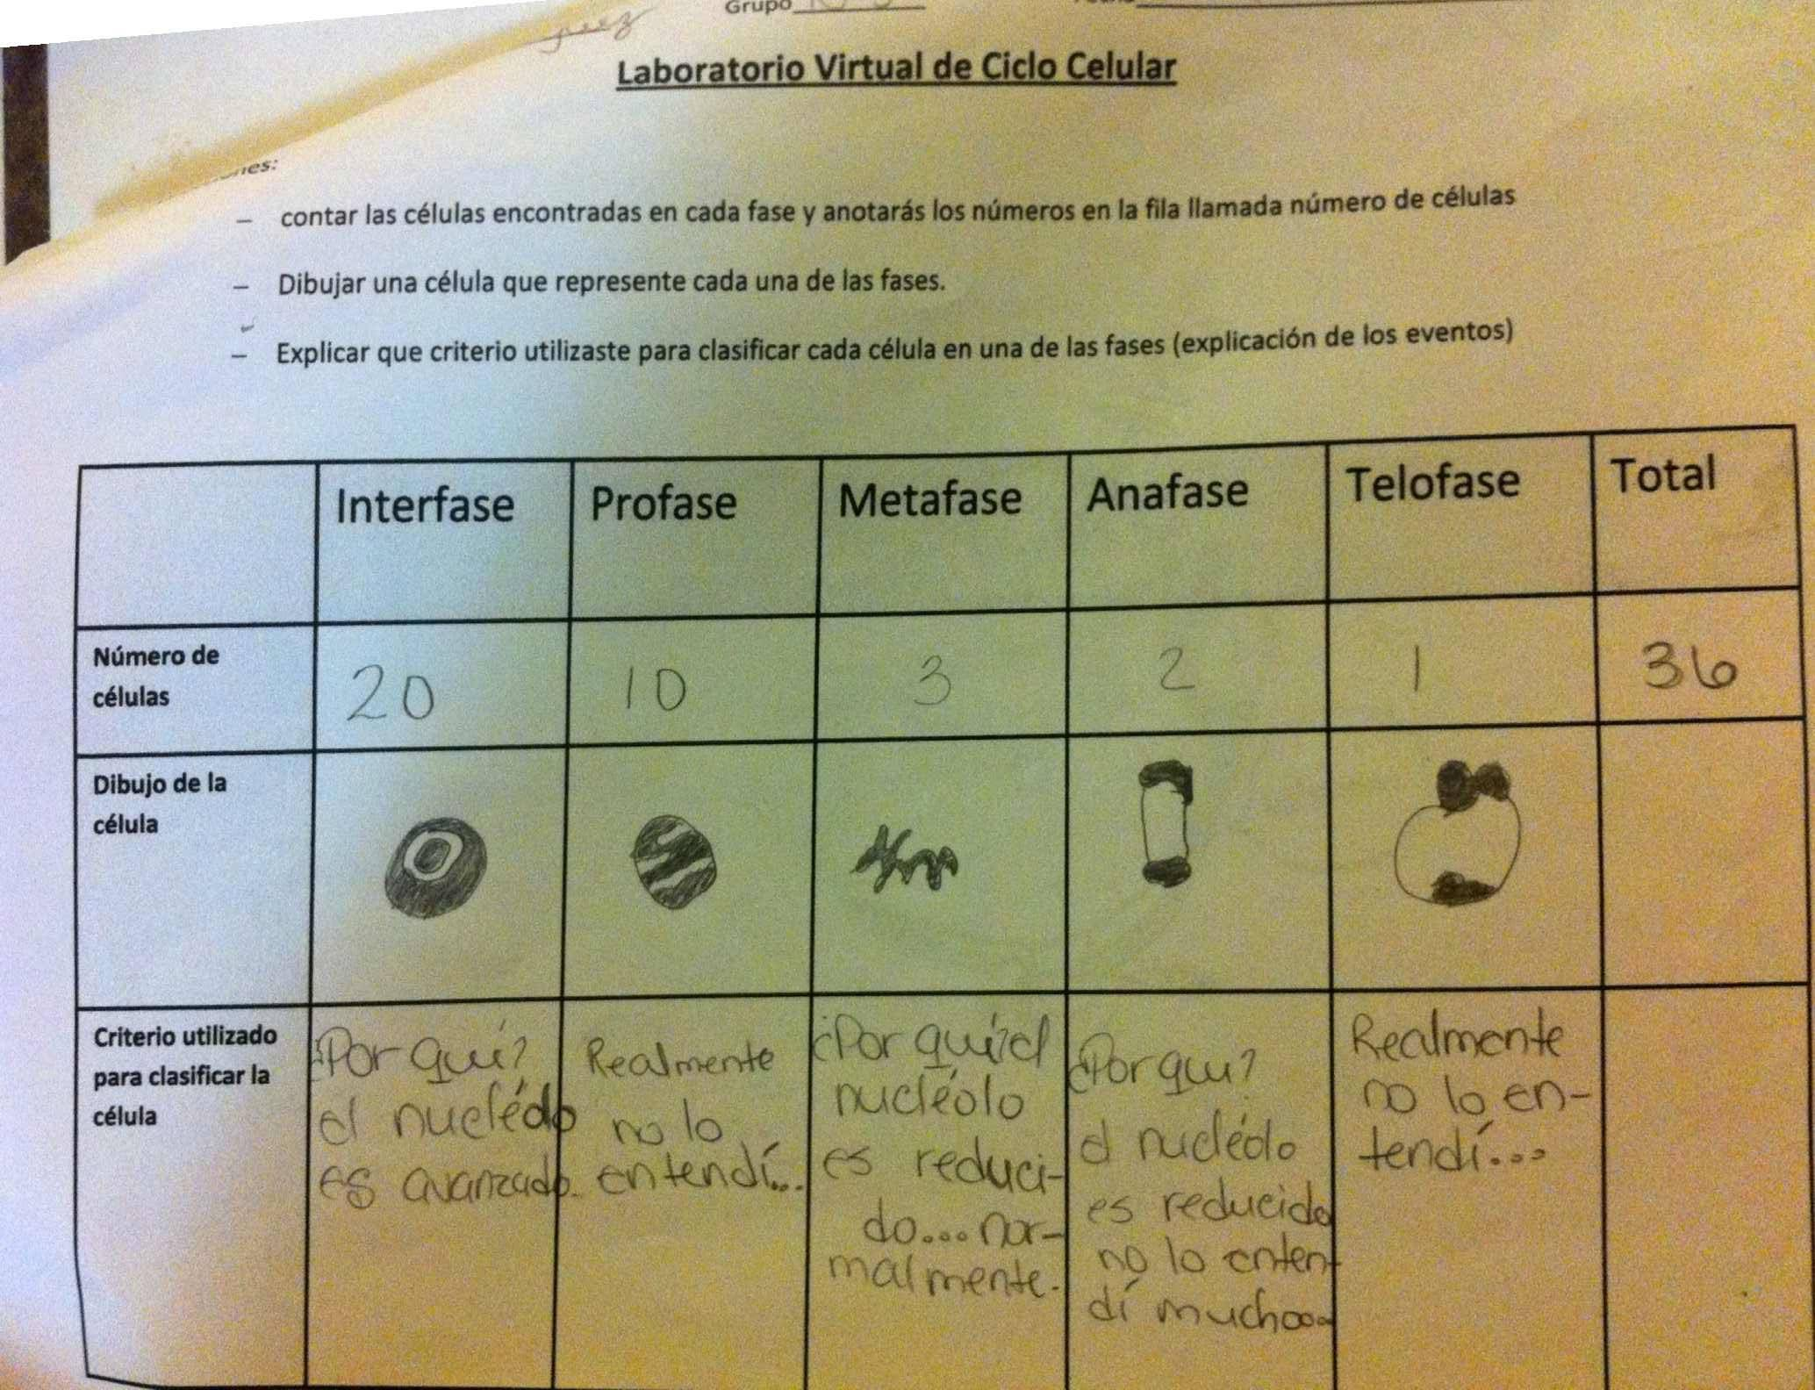
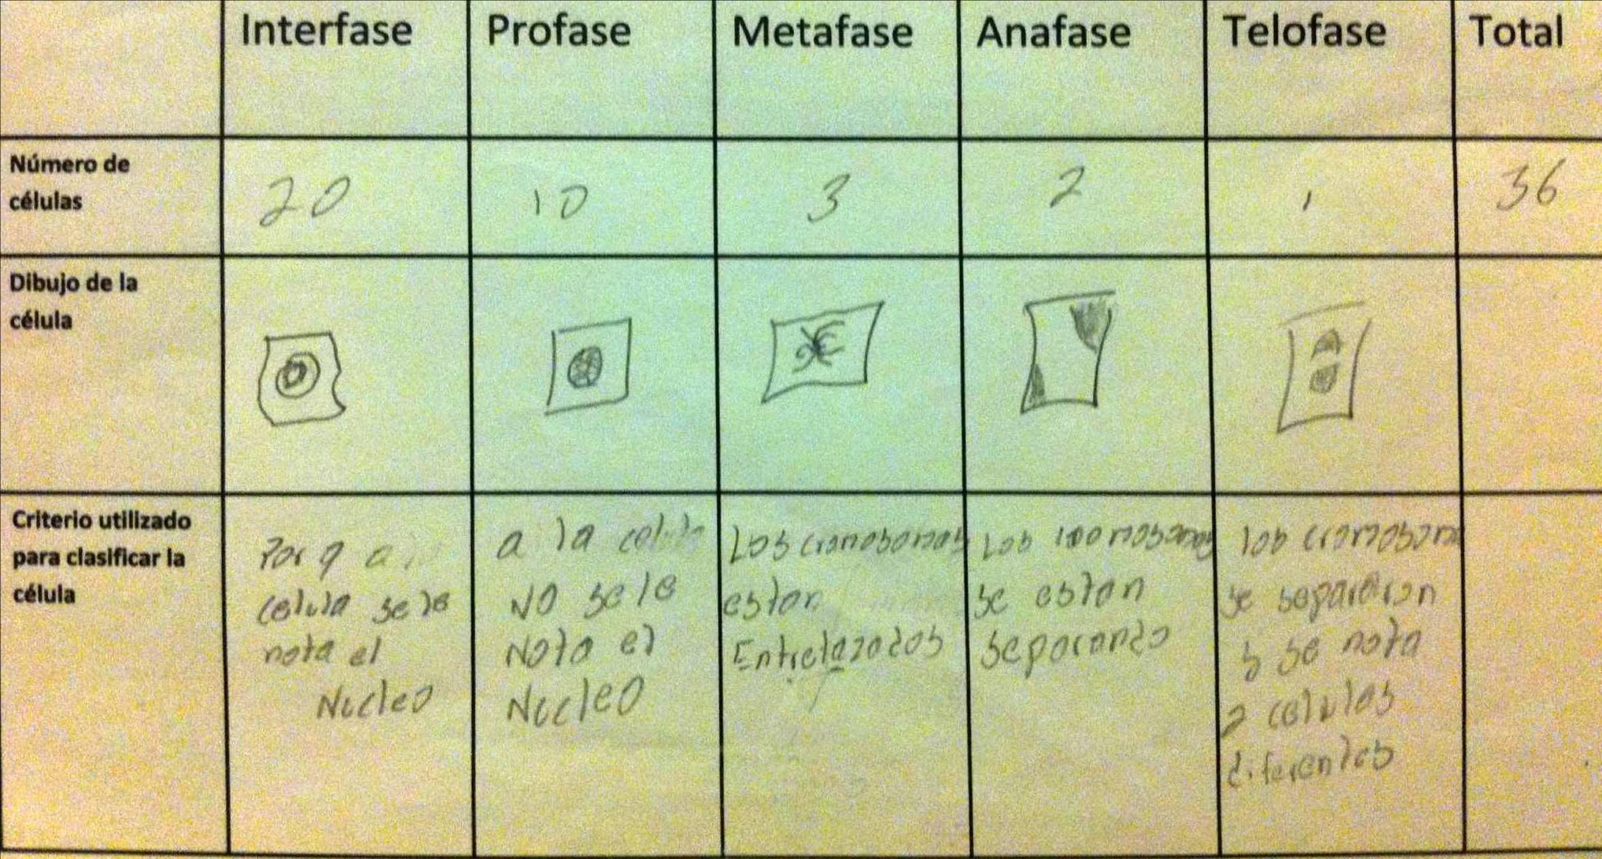
Virtual Lab
Virtual Lab Journal Comments:
Virtual Lab: “Today I really learn to classify the phase of the cell”.
Virtual Lab: “At the beginning I don’t pay attention how to classify the phase of the cell, but with the repetition I understand how to make it”.
Notes:
Another methodology was the virtual lab in which students had to identify the phase in which the cell is found. In total the student had to classify 36 cells, the process being repetitive and allowing that the student denote particular characteristics in cells. Initially all accepted difficulty to identify the cells, but that as they passed through the repetition they understood as classifying them.

Slide 78
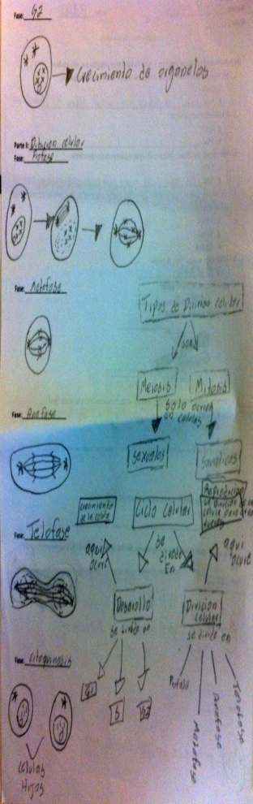
Test
ADD/ADHD Actual Year Cell Cycle Mitosis Test
Student #1
Student #2
Student #3
Student #4
Student #5
Student #6
Student #7
Notes:
Most of the students succeed to establish relationship between phases and the events that occurred in the cell. They also completed the diagram, showing through drawing the majority of the events. Certain, some of them forgot several details, but compared to tests of the students of the previous year, they showed a significant improvement in the execution of the test. Students expressed feel more confident when taking the test.

Slide 79
Other Students Journal Comments
“The videos help me to understand what happen with the cell”.
“I prefer the classroom, the class is more dynamic”.
“I am understanding more and I am attentive”. and if I don’t understand, well I repeat it again.
Special Education Teacher Comments
“This module was a great, it helps students because it allows to repeat the lessons as many times as necessary. This permit students learn the concepts much better”.
“An interactive module gives you the opportunity to better visualize the processes occurring in the cell and obtain a greater learning”.

Slide 80
Final Reflection
Modifications to the module
Record the name of the students and the score every time they perform quizzes.
Availability of the module for all students
Create others module for topic of high complexity.

Slide 81
Thanks for your attention…

